Slide 1


LegalGPT:
AI-Powered Legal Assitant with RAG and LLM Support

Slide 2


ABSTRACT
🧠 Core Idea: An AI-driven legal chatbot that assists users in drafting, understanding, and retrieving legal documents.
🔍 Problem Solved: Legal queries and document drafting usually require lawyers, which can be expensive and time-consuming.
📜 Our Approach: Combines Retrieval-Augmented Generation (RAG) with legal document ingestion to answer queries, extract clauses, draft contracts, and send formal letters.
🛠️ Tech Stack: Flask, LangChain, ChromaDB, Ollama LLM, SQLite, ReportLab (PDF), SMTP (email).
🤝 Personalization: Secure login, personal dashboard, advocate search, and instant document-based legal assistance.

Slide 3
FEATURES OF
THE PROJECT
Upload PDF/DOCX legal documents for analysis.
AI-powered legal Q&A chatbot.
AI Writing of legal documents (agreements, NDAs, contracts).
AI based Drafting & sending
legal mails via email.
Advocate search by location & specialty.
Download AI-generated legal documents as PDFs.

Slide 4

EXISTING
SYSTEM
Manual Legal Consultation:
Users depend on lawyers for queries & drafting.
Paper-based legal workflows still dominant.
Expensive, time-consuming, and limited availability.
Legal research requires manual search through large volumes of text.
Limitations:
High cost 💰
Time-consuming ⏳
Risk of human error ❌
No instant access

Slide 5

Problem 1:
Problem 2:
Time Consuming
Risk of Error
DISADVANTAGES OF
Manually reading through hundreds of pages of legal text to find information is incredibly slow
Human fatigue and oversight can lead to missing critical details
EXISTING SYSTEM
Problem 3:
Problem 4:
Inefficient Drafting
Limited Accessibility
Information is not easily searchable. Standard search functions
Relies on finding, copying, and pasting from old templates

Slide 6
COMPARISON
PARAMETER | EXISTING SYSTEM (Manual/Traditional) | PROPOSED SYSTEM (Legal AI Platform)
ACCURACY | Variable, prone to human error and oversight. | High, based on the context of the provided document.
Input Type | Physical or digital documents requiring manual reading. | Digital documents (PDF, DOCX) for AI processing.
Data Accessibility | Slow; relies on manual reading or basic keyword search. | Instant; allows for semantic, conversational queries.
Personalization | Generic process; not tailored to individual documents. | Highly personalized; all AI interactions are based on the user's specific uploaded content.

Slide 7

Proposed
System

Slide 8
Proposed System
🖼️ User Authentication & Document Upload: The user securely logs in and uploads a legal document (PDF or DOCX) via the web interface.
⚙️ Data Preprocessing & Ingestion: The system uses LangChain to load the document, split it into smaller text chunks, and generate vector embeddings using the LLM model. These embeddings are stored in a ChromaDB vector database.
🤖 AI-Powered Interaction: The user asks a question, requests a clause, or makes a drafting request through the chat interface.

Slide 9
Proposed System
📊 RAG-Based Response Generation: The system retrieves the most relevant text chunks from ChromaDB based on the user's query. These chunks are passed to the LLM as context. The LLM generates a response based only on this provided context.
📌 Result Generation: The AI-generated answer, extracted clause, or drafted document is displayed instantly to the user on the web page.

Slide 10
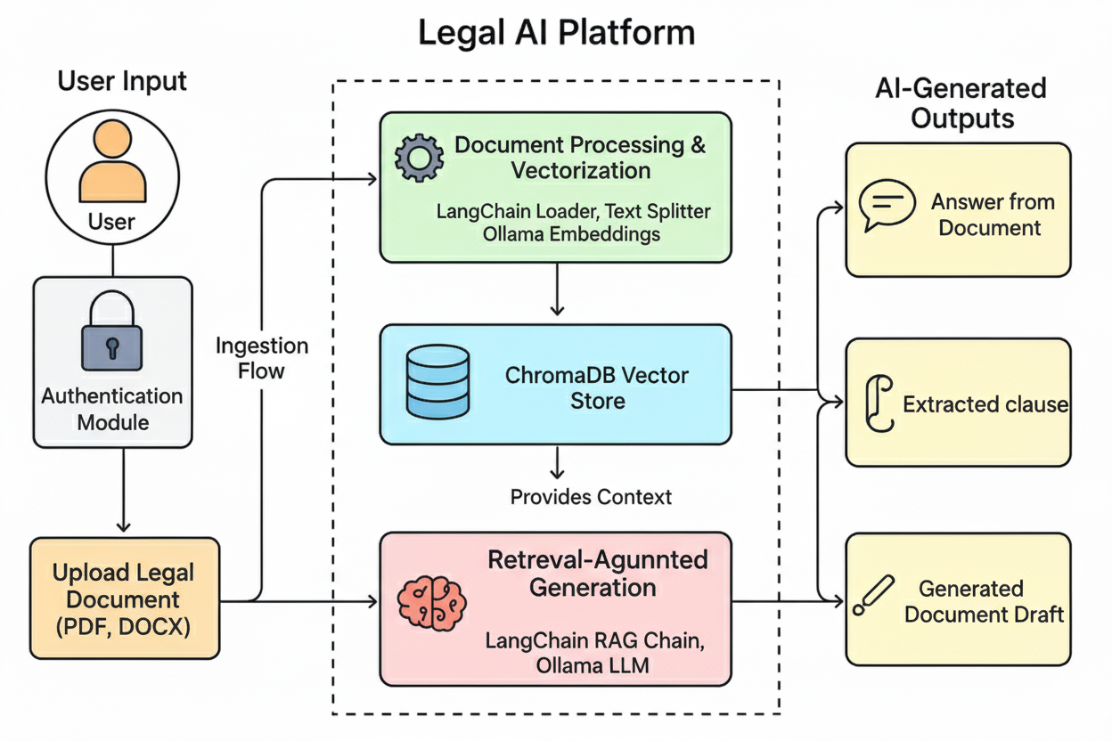
PICTORIAL DIAGRAM

Slide 11
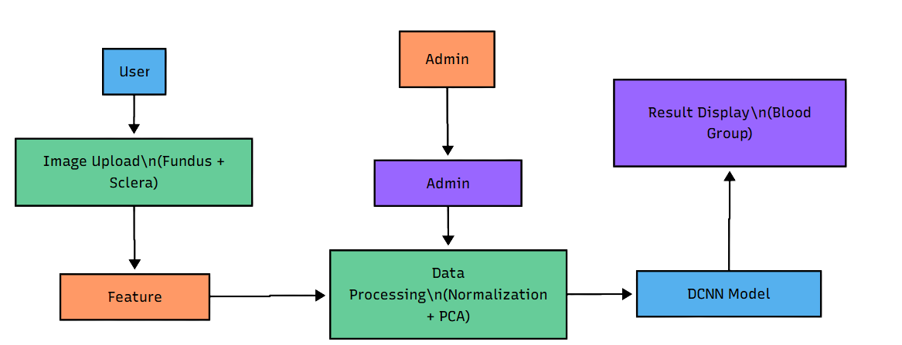
ARCHITECURE

Slide 12

ADVANTAGES OF
THE PROJECT
Secure: Users interact with their own documents in a private session.
Fast & Efficient: Provides answers and drafts in seconds,
Context-Aware & Accurate: By using a RAG pipeline, the AI's responses are grounded in the specific source document
Versatile: Serves multiple functions—Q&A, clause extraction, document drafting, and communication—all within one platform.

Slide 13




Modules
& Process
1.User Authentication Module
2.Document Upload Module
3. AI Interaction Module
4. Document Generation Module
Handles secure user registration and login using hashed passwords and session management.
Allows users to upload .pdf and .docx files, which are saved to the server for processing.
Provides an interface for chatting with the AI, with specific functions for asking general questions (/chat) and extracting clauses (/extract_clause).
Generates legal document templates using the LLM (/generate_document) and allows users to download the result as a PDF (/download_pdf).

Slide 14




Modules
& Process
5.Advocate Search Module
6.Legal Communication Module
7.Visualization Module
8.Admin Management Module
A utility that searches a pre-defined list of advocates by location and specialty (/find_advocates).
Drafts a formal letter based on user input (/draft_legal_mail) and sends it to a specified recipient via email (/send_legal_mail).
Generates performance graphs, including accuracy/loss curves and confusion matrix, for model evaluation
Enables admins to upload new datasets, retrain the model, and manage stored results through a dashboard.

Slide 15
SOFTWARE / HARDWARE REQUIREMENTS
SOFTWARE REQUIREMENTS
System : Pentium i3 Processor.
Hard Disk : 20 GB.
Monitor : 15’’ LED
Input Devices : Keyboard, Mouse
Ram : 4 GB
HARDWARE REQUIREMENTS
Operating system : Windows 10 Pro, MAC OS
Coding Language : Python , HTML, CSS,JS
Web Framework: Flask
Key Libraries: LangChain, Ollama, Flask-SQLAlchemy, ReportLab.
Database : ChromaDB for RAG and SQLite

Slide 16
CONCLUSION
The Legal AI Platform successfully demonstrates the power of integrating Large Language Models with a Retrieval-Augmented Generation pipeline to create a powerful tool for legal professionals. It transforms the slow, manual process of document analysis into a fast, interactive, and efficient experience. By providing context-aware answers and automating drafting tasks, the platform reduces the risk of human error and allows legal experts to focus on higher-value strategic work. Future enhancements could include integration with legal case databases and more advanced analytical capabilities.

Slide 17
REFERENCE
[1] P. Lewis, E. Perez, et al., "Retrieval-Augmented Generation for Knowledge-Intensive NLP Tasks," in Advances in Neural Information Processing Systems 33 (NeurIPS 2020), 2020.
[2] A. Vaswani, N. Shazeer, N. Parmar, et al., "Attention Is All You Need," in Advances in Neural Information Processing Systems 30 (NIPS 2017), 2017.
[3] D. M. Katz, M. J. Bommarito II, S. Gao, and P. Arredondo, "GPT-4 on the Bar Exam: An Early Look at Large Language Model Performance on the Uniform Bar Exam," SSRN Electronic Journal, 2023.
[4] I. Chalkidis, M. Fergadiotis, et al., "ContractBERT: A Pre-trained Language Model for Contract Understanding," in Proceedings of the 2021 Conference on Empirical Methods in Natural Language Processing, 2021.
[5] LangChain AI, "LangChain Documentation," LangChain, Available: https://python.langchain.com/docs/get_started/introduction. [Accessed: 2025].

Slide 18

Thank
You

